Slide 1
Employee Data Analysis using Excel
STUDENT NAME: Bharathi.P.T
REGISTER NO: 312209408
DEPARTMENT: B.com Accounting and finance
COLLEGE: Anna Adarsh college for women

Slide 2
PROJECT TITLE
Employee Performance Analysis using Excel

Slide 3


AGENDA
Problem Statement
Project Overview
End Users
Our Solution and Proposition
Dataset Description
Modelling Approach
Results and Discussion
Conclusion
3/21/2024 Annual Review

Slide 4

PROBLEM STATEMENT
The Performance of a Employee Should be analysed to:
Improve the areas to be developed of the performance of the employee.
Identify training needs and provide development opportunities
To identify trends, strengths, and weakness of the employee.

Slide 5

PROJECT OVERVIEW
Analysing the performance of employee by considering various factors like gender, performance level,ratings.
The employee database contains various attributes such as employee ID, name, department, job title, starting data, employee type (full-time / part-time), employee status(voluntarily terminated, active, etc).

Slide 6

WHO ARE THE END USERS?
The end yours of my project (employee data analysis by using excel are:
HR Managers
Business Analysts
Manager
Employer
Employee
And other member of organisation

Slide 7

OUR SOLUTION AND ITS VALUE PROPOSITION
Conditional formatting: To highlight missing values
Filter: to remove missing values
Formula: to calculate performance of the employee
Pivot table: To summarize, analyse a large datasets
Graph: To visualize

Slide 8
Dataset Description
Employee data from Kaggle
It has 11 features
I’ve taken 7 features
First name- value
Business unit- access
Gender code- filter
Current employee rating- series
Department
Employee type
Work location

Slide 9

THE "WOW" IN OUR SOLUTION
PERFORMANCE LEVEL=
=IFS(Z8>=5, “VERYHIGH”,Z8>=4, “HIGH”,Z8>=3,”MED”,4
TRUE,”LOW”)
3/21/2024 Annual Review
9

Slide 10
MODELLING
DATA COLLECTION:THE DATA COLLECTION WAS DOWNLOAD IN “KAGGLE”.
FEATURE COLLECTION:IN THIS DATA BASE IT HAS 11 FEATURES I HAD USE 7 FEATURS OF MY PROJECTS.
DATA CLEANING:IN THIS STEP I HAD IDENTIFY THE MISSING VALUE AND REMOVE THE BLANK.
PERFOMANCE LEVEL:I HAD CALCULATE THE EMPLOYEE DATA BY USING FORMULA =IFS(J4>5,"high",J4>3,"med","true","low")
SUMMARY:FOR MY PROJECT I HAD USE PIVOT TABLES FOR EMPLOYEE DATA ANALYSIS.
VISUALIZATION:FOR MY PROJECT I HAD USE TO VISULIZED MY EMPLOYEE DATA ANALYSIS AS “GRAPH”.
10

Slide 11
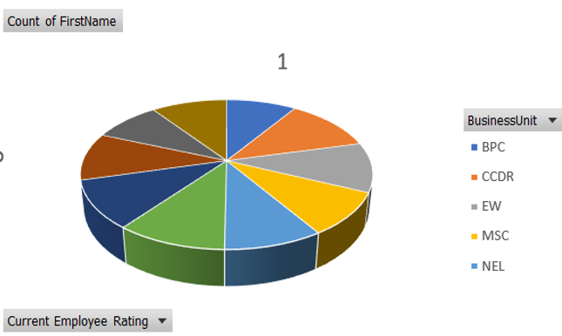
RESULTS
11

Slide 12
conclusion
The topic of my project is “EMPLOYEE PERFOMANCE ANALYSIS USING EXCEL”. In this presentation I have given the project overview about the employee data analysis, who are the end users of the employee data analysis, our solution and its value proposition, data description, The “wow” in our solution which was uses as formula for(employee performance level), modelling , result view as graph using excel by pivot table using employee data analysis which was download in website (www.kaggle.com datasets).

